Slide 1
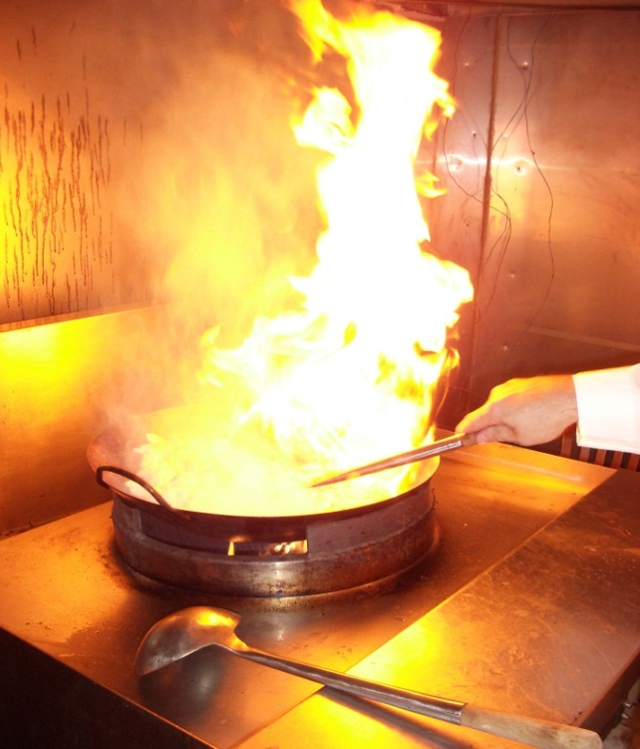
PM_{2.5} Emissions from Cooking
Largest single source of PM_{2.5} emissions indoors when no occupants are smoking
Measured Indoor Concentrations of PM_{2.5} (μg/m³)
Food Court 200 (U.S.)
Hunan Restaurant 1406 (China)
Cantonese Restaurant 672 (China)
Hot Pot Restaurant 81 (China)
Cooking Fuel Used in Different Areas of China
 |  | Solid Fuel, % |  |  | Clean Fuel (or Energy), %
 |  | Subtotal | Organic Fuel | Coal | Subtotal | Gas Fuel | Electricity or Solar
Total |  | 44.2 | 32.7 | 11.5 | 55.4 | 43.2 | 12.2
 | Urban | 19.3 | 10.8 | 8.5 | 80.2 | 66.6 | 13.6
 | Rural | 65.3 | 51.3 | 14.0 | 34.2 | 23.3 | 10.9

Slide 2
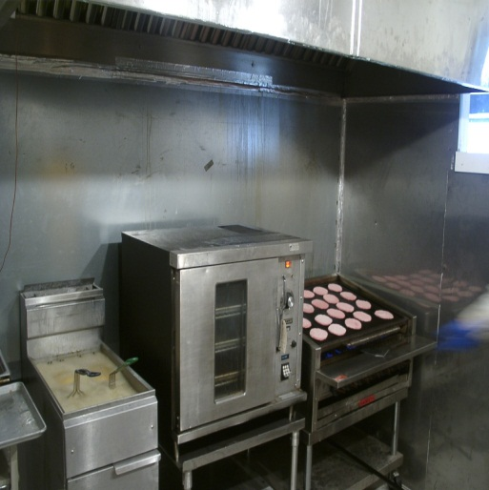
Restaurant Data
A Significant Source Outdoors
                U.S. China
Total Restaurants in Country: 990,000 2,367,000
                (64,000 in CA) (41,000 in Beijing)
National Sales in 2013: $660 billion $268 billion
National Employees: 13.1 million 12.1 million
(10% of U.S. workforce)
U.S. PM_{2.5} Emissions (tons/yr)
Cooking (Charbroiling) Vehicle Emissions
79,000 135,000

Slide 3
Total Emissions Measured in Exhaust Duct

Slide 4
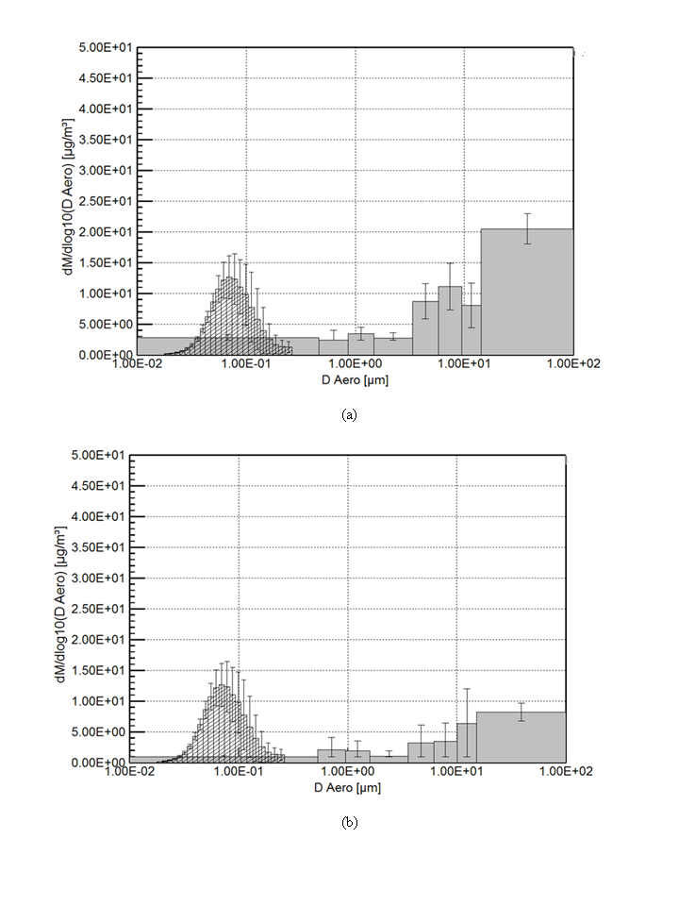
Particulate Emissions in Exhaust Duct from an Over-Fired Broiler Cooking Steak
PM₁₀
PM_{2.5}

Slide 5
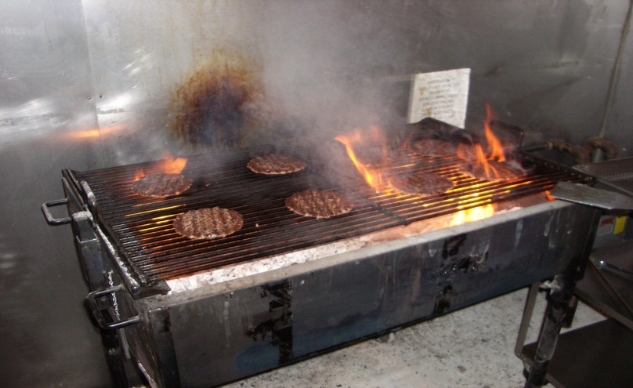
Particulate Emissions Regulations
U.S.
Bay Area Air Quality Management District
Regulation 6 (Particulate Matter)
Rule 2 (Commercial Cooking Equipment)
Chain-Driven Charbroilers and Under-Fired Broilers
Emissions limited to no more than 1.0 pound of PM₁₀ per 1000 pounds of beef cooked (1.0 kg of PM₁₀ per 1000 kg of beef cooked)
Effective January 1, 2013

Slide 6
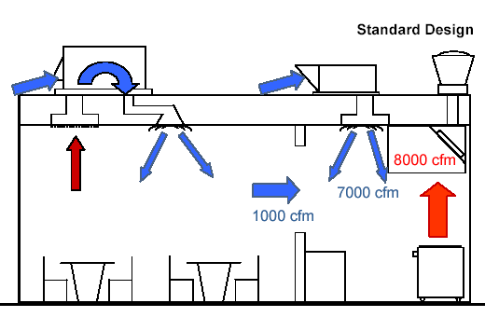
Particulate Emissions Regulations
China
GB 18483-2001
Maximum allowable PM_{2.5}
2 mg/m³
Not a good measure as adding more outdoor air
for dilution can be used to satisfy the requirement
but with significant energy penalty.

Slide 7
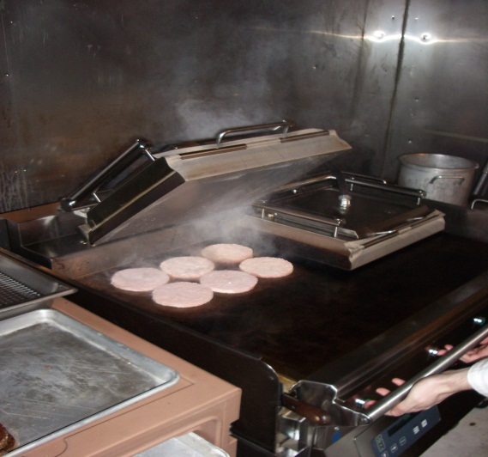
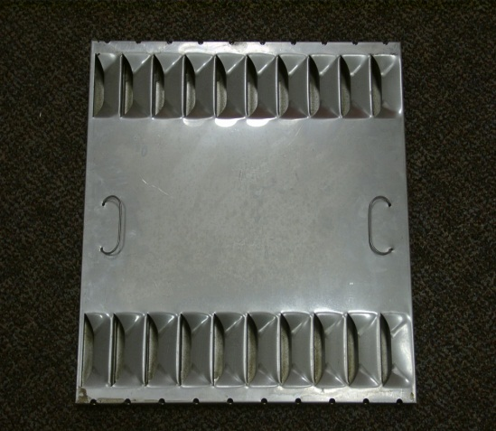
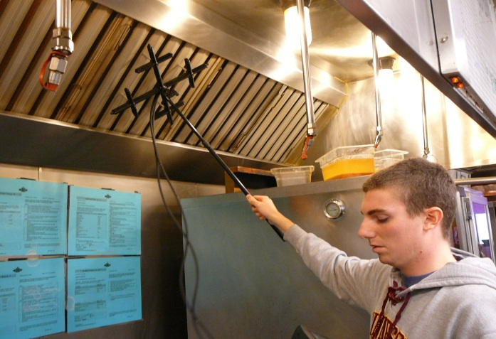
Where do we go from here?
The majority of residential and commercial cooking emissions remains uncontrolled. Clean energy sources should be promoted and improved residential and commercial capture and exhaust systems are needed.
Small particles are not captured with existing grease filters and grease vapor removal has not been addressed.
Novel cooking appliances, emission control systems, sensors, and controls are needed.

Slide 8
Review of Residential Cooking Emissions
Abdullahi, K. L., Delgado-Saborit, J. M. and Harrison, R. M. (2013), “Emissions and Indoor Concentrations of Particulate Matter and its Specific Chemical Components from Cooking: A Review”, Atmospheric Environment 71:260-294.
Selected Research Reports On Commercial Kitchens Available from ASHRAE
Gerstler, W. D., Kuehn, T. H., Pui, D. Y. H., Ramsey, J. W., Rosen, M. J., Carlson, R. R. and Petersen, S. D., “Identification and Characterization of Effluents from Various Cooking Appliances and Processes as Related to Optimum Design of Kitchen Ventilation Systems.” Final Report, ASHRAE 745-RP Phase II, July, 1998.
Kuehn, T.H., Olson, B.A., Ramsey, J.W. and Rocklage, J., “Characterization of Effluents from Additional Cooking Appliances,” Final Report, ASHRAE 1375-RP, April 24, 2008.
Kuehn, T. H., Olson, B. A., Bissell, D., Campbell, K. and Hawkinson, A., “Method of Test to Evaluate Field Performance of Commercial Kitchen Ventilation Systems,” Final Report, ASHRAE 1376-RP, July 6, 2010.

